Slide 1
Accuracy Report

Slide 2
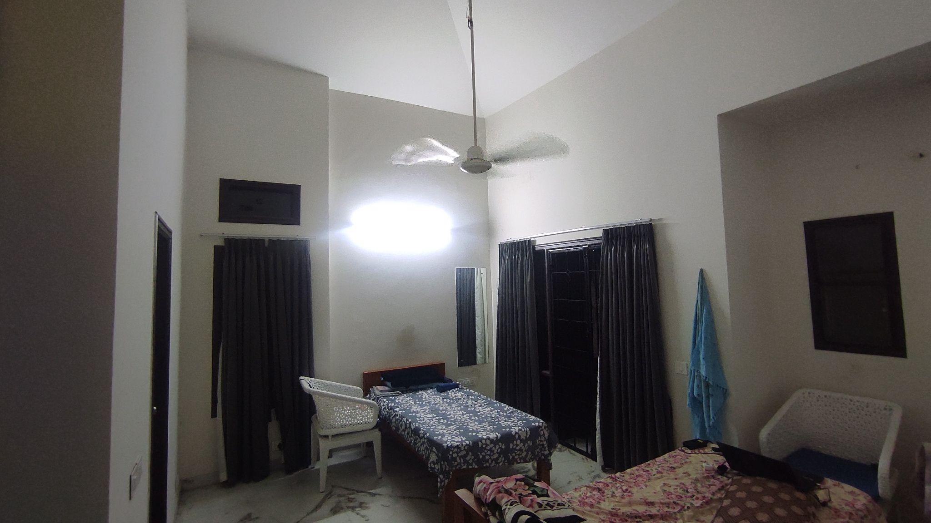
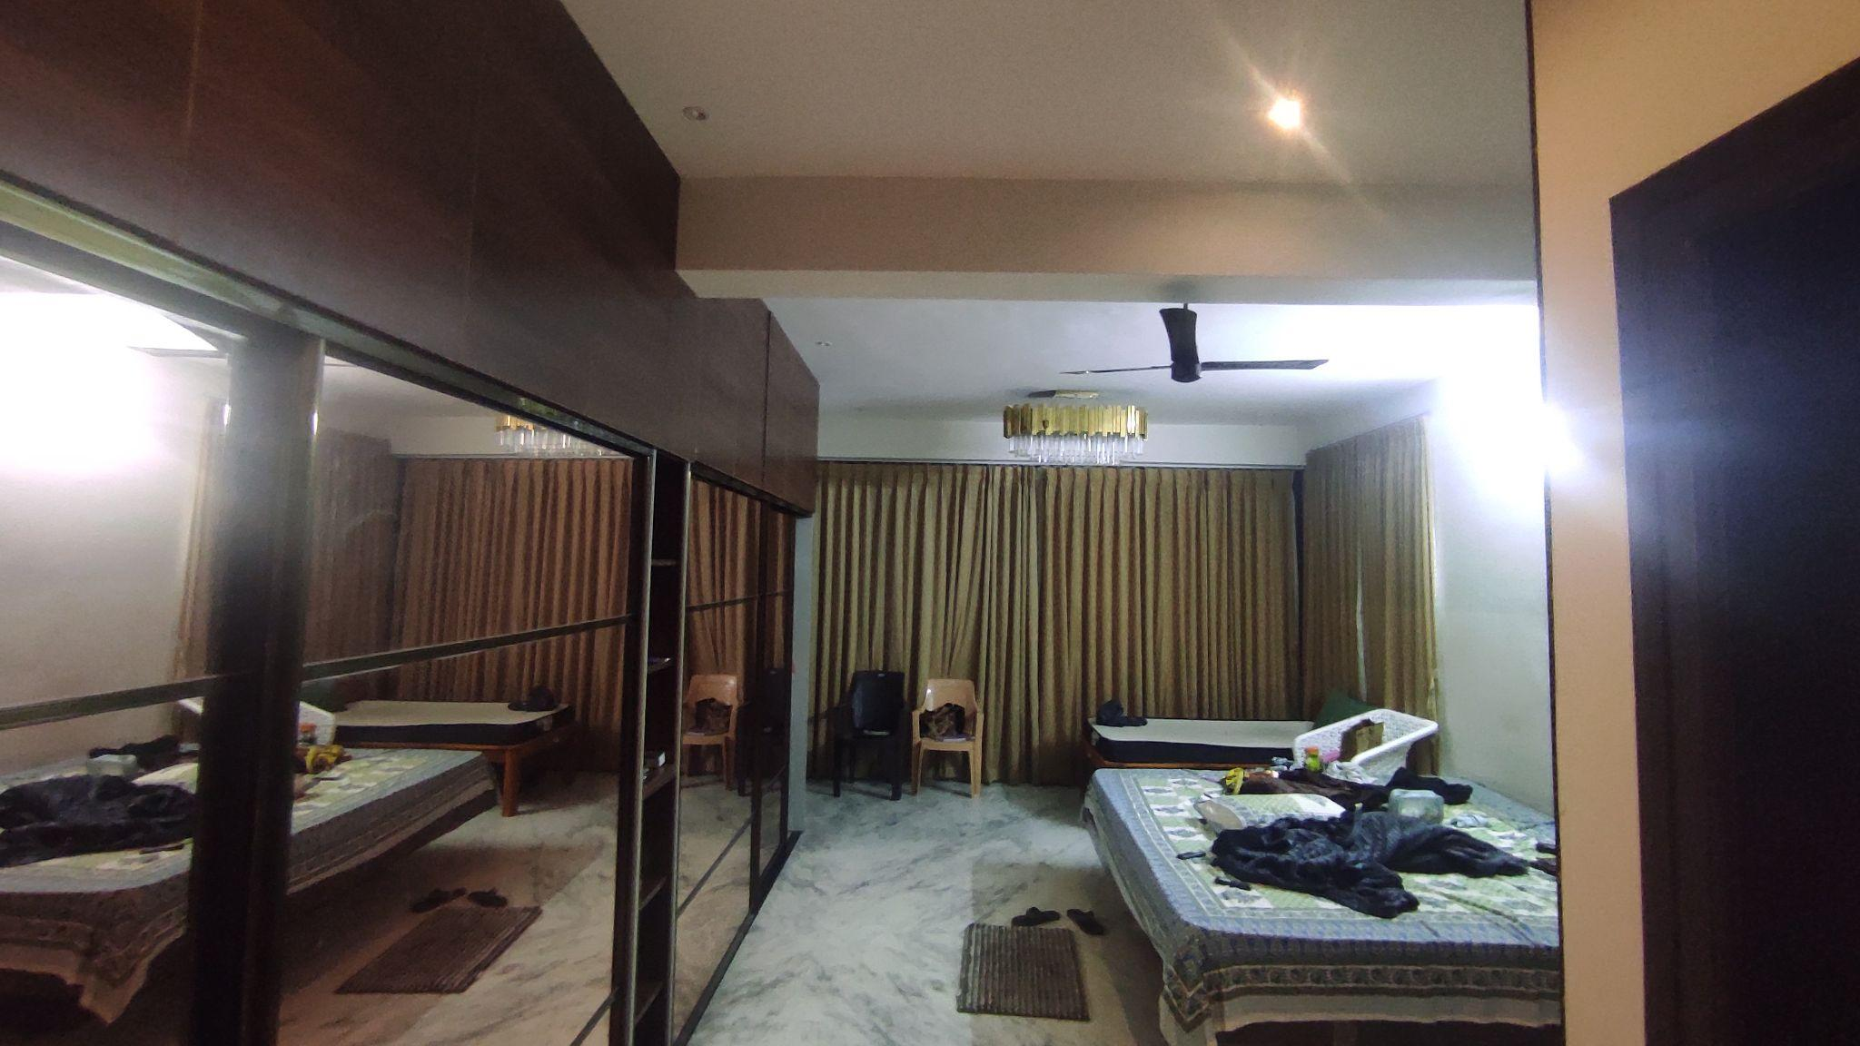
Room Details
Room 1 - Simple Room - 2 Windows,2 Doors,2 Cupboards
Room 2 - Large room - 3 Doors, 1 Large Mirror, 1 Window
All actual measurements were captured using the iPhone 18 Pro LiDAR sensor.
Room 1
Room 2

Slide 3
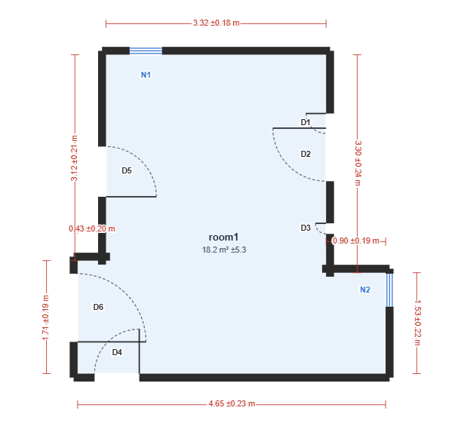
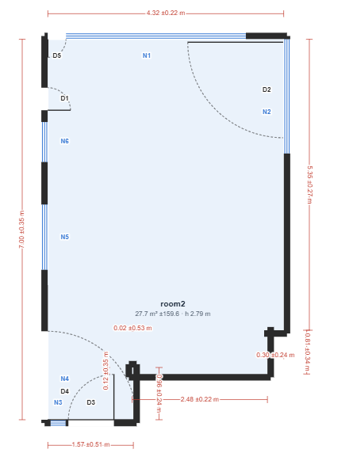
Photos Tier
8 photos taken from 8 standard angles
Maintained a consistent clockwise capture order.
Room 1
Room 2

Slide 4
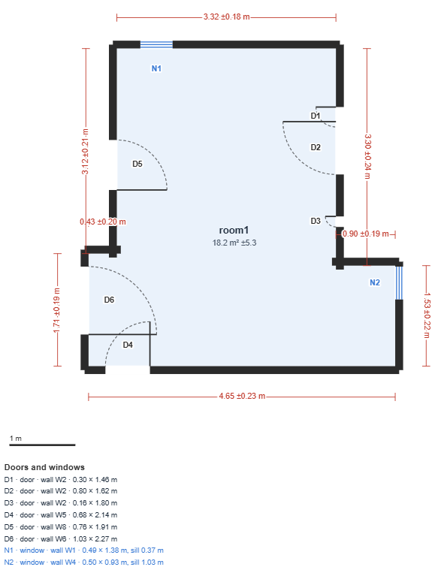
Item | Actual (m) | Difference (Pred - Actual) | Remarks
D4 | 0.89 x 2.14 | Width -0.21 | Accurate length
D6 Wall | 1.8 | Length -0.09 | Within acceptable error
D5 | 0.81 x 2.14 | Width -0.05 Length -0.23
D1,D2,D3 | - | - | Single door misclassified as 3 doors
N2 | 0.48 x 93 | Width -0.02 | Near-perfect accuracy
W5 | 4.36 | Length -0.29
W1 | 3.27 | Length +0.05 | Within acceptable error

Slide 5
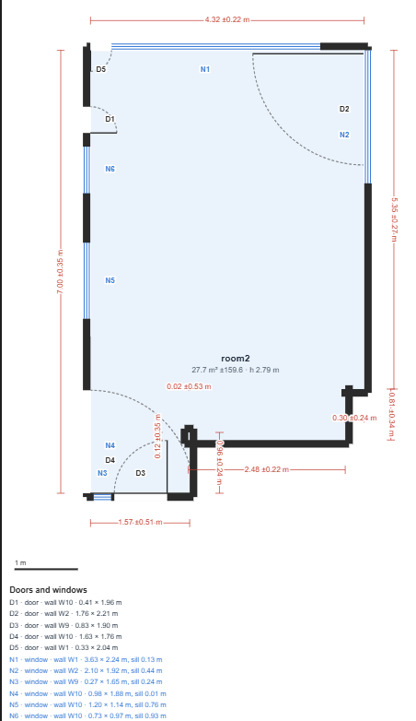
Item | Actual (m) | Difference (Pred - Actual) | Remarks
W1 | 4.41 | Length -0.09 | Within acceptable error
D4,N3,N4,N5, N6,D2 | - | - | Mis classification of door and windows
W10 | 7.17 | Length +0.17 | Within acceptable error
Ceiling ht | 2.72 | Length +0.07 | Excluded; ceiling not visible in photos

Slide 6
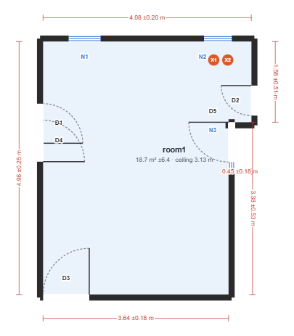
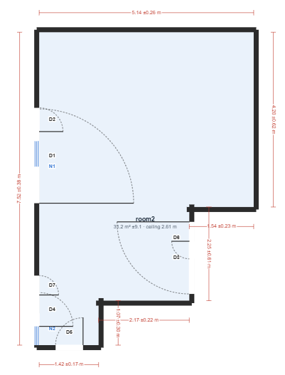
Videos Tier
Room 1 Video: Contains voice narration describing structural damage.
Room 2 Video: Standard walkthrough; no structural damage noted.
Room 1
Room 2

Slide 7
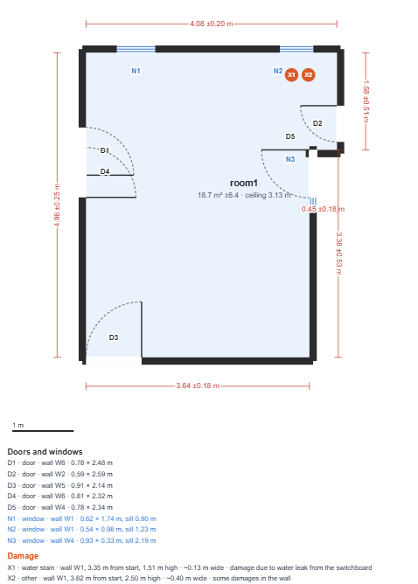
Item | Actual (m) | Difference (Pred - Actual) | Remarks
D4 | 0.89 x 2.14 | Width +0.02 | Exact length; minor width variance
D1,D4 | - | - | Single door misclassified as 2 doors
N2 | - | - | Mirror misclassified as a window
X1,X2 | - | - | Structural damage accurately identified
Ceiling ht | Corner:3 Include dome: 5.07 | Length +0.13 | Excluded; ceiling dome not captured in video

Slide 8
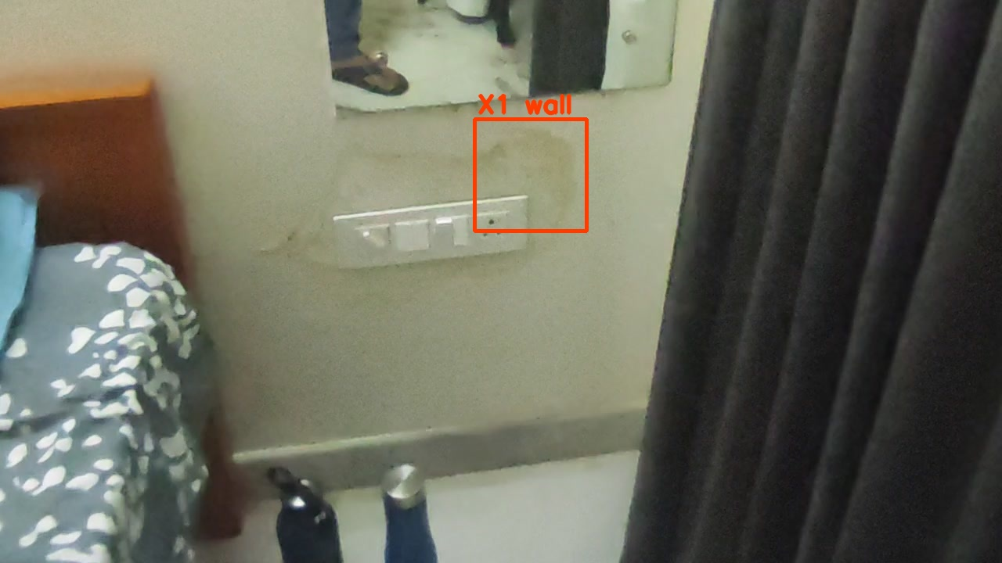
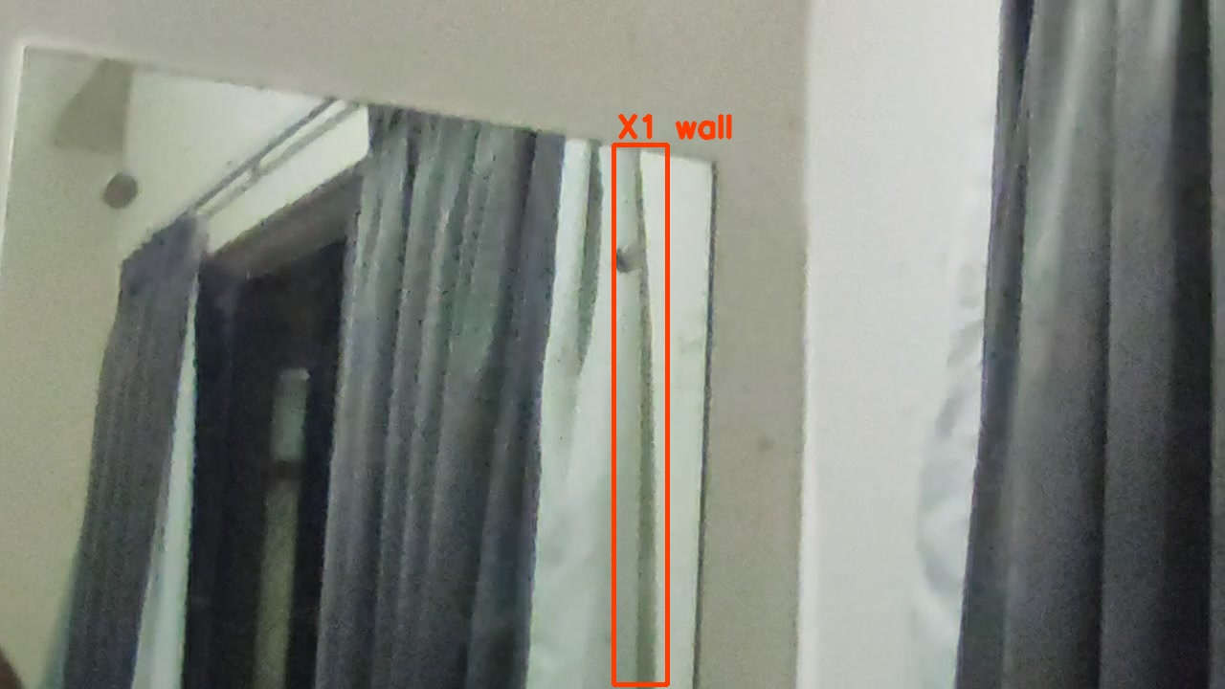
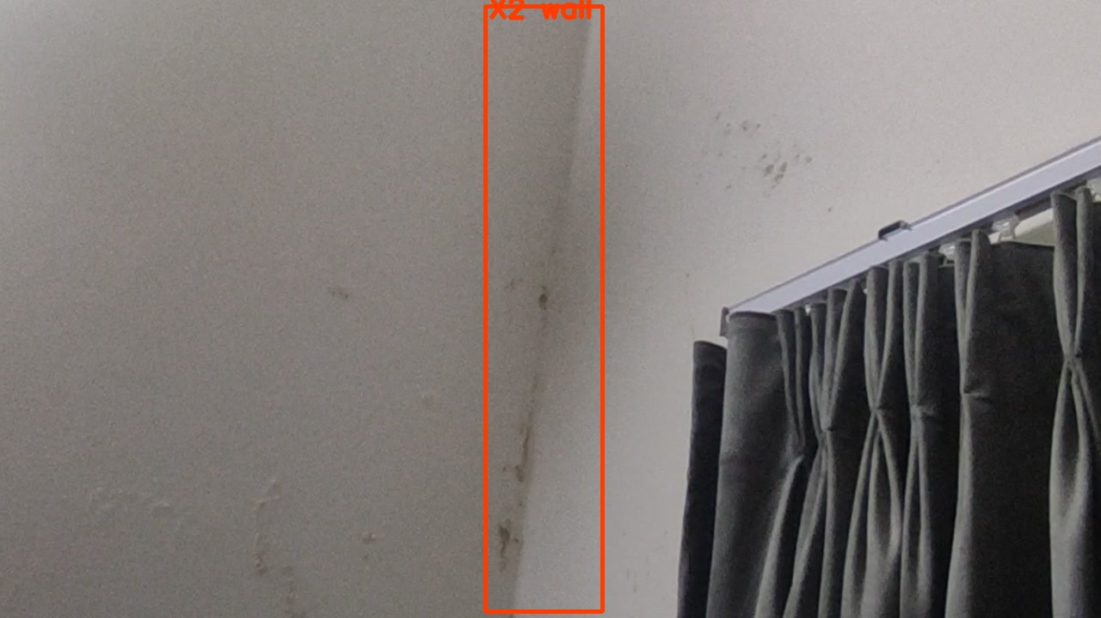
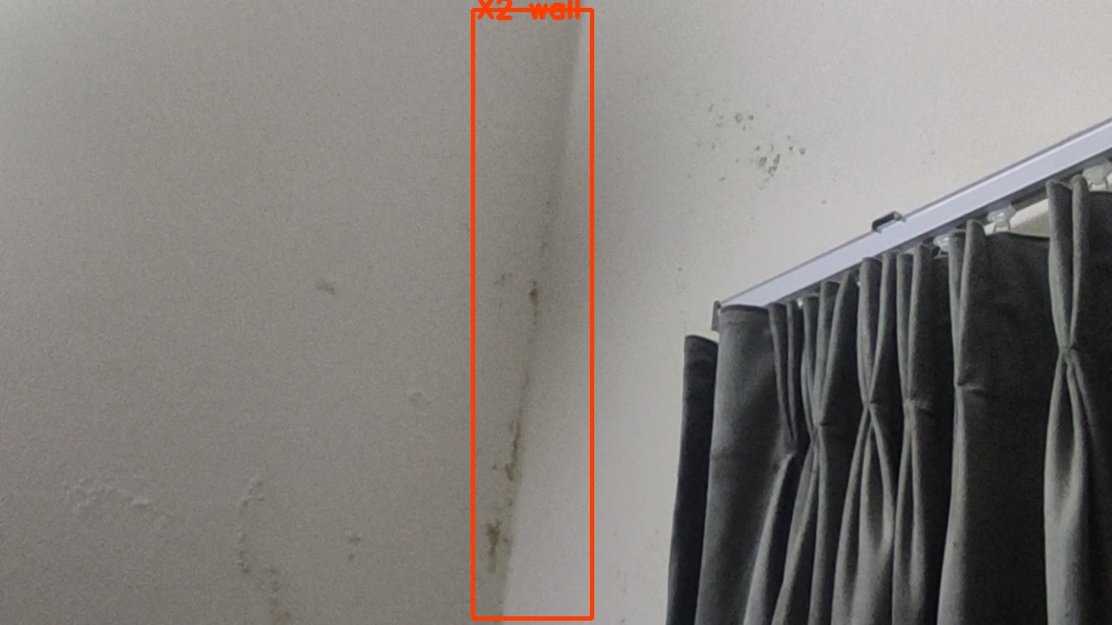

Slide 9
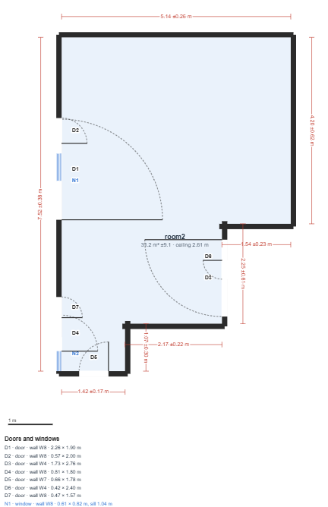
Item | Actual | Difference (Pred - Actual) | Remarks
D1,D2,D7,D4 | - | - | Wrong identification of mirror
room2 | - | - | Position is wrong

Slide 10
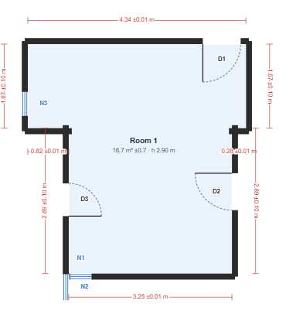
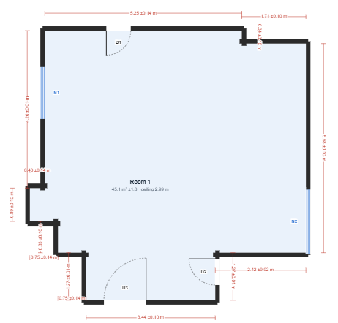
Lidar Tier
Stray scanner app is used and shot in iphone 18 pro
Room 1
Room 2

Slide 11
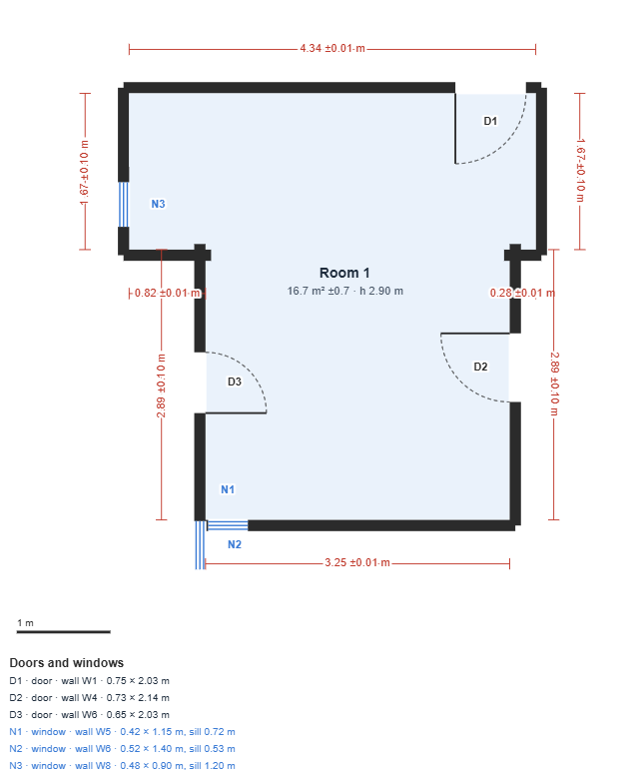
Item | Actual | Difference (Pred - Actual) | Remarks
D1 | 0.89 x 2.14 | Length:-0.11 Width -0.14 | Within acceptable error
W8 | 1.63 | Length: +0.04 | Within acceptable error
D2 | 0.81 x 2.14 | Width: -0.08 | Perfect
N1,N2 | - | - | Mirror misclassified
N3 | 0.48 x 0.93 | Length: +0.03 | Perfect
Ceiling ht | Corner:3 Include dome: 5.07 | Length -0.1 | Video didn't capture the dome
The layout was correct, predictions were near accurate compared to images,videos route. But the mirror issue still exists

Slide 12
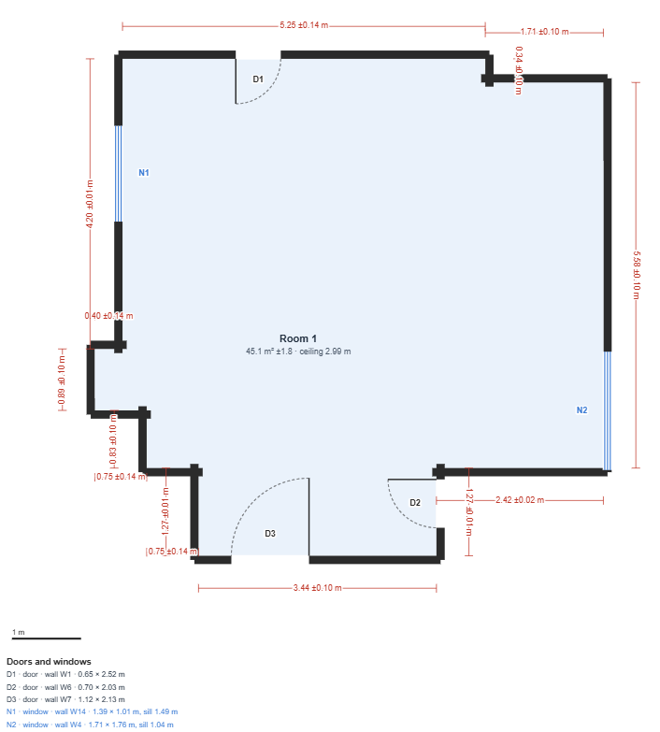
Item | Actual | Difference (Pred - Actual) | Remarks
D3 | 1.17 x 2.03 | Length:+0.1 Width -0.05 | Within error
D2 | 0.83 x 2.1 | Length:-0.07 Width:-0.13 | Within error
The layout got really messed up due to long mirrors

Slide 13
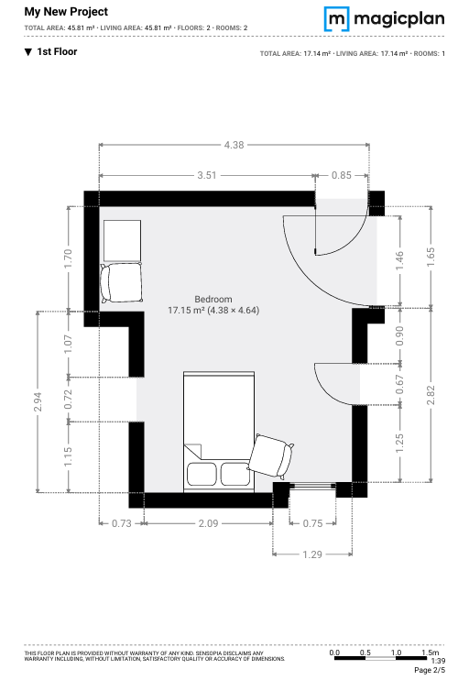
Magic Plan Room 1
The Layout is excellent.
Correctly identified the objects
Missed 1 window

Slide 14
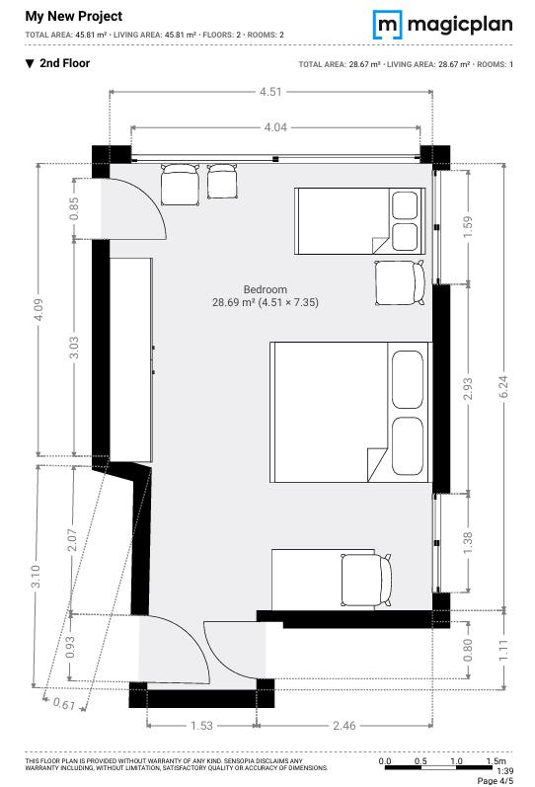
Magic Plan Room 2
Mirror Problem still exists
Correctly identified the objects

Slide 15
Takeaways
Accuracy for door dimensions (within a 0.15 - 0.30 m range) - Low.
Structural damage accurately detected.
Inconsistent object identification across rooms.
Severe hallucinations caused by mirror reflections.
MagicPlan offers far superior report generation and user experience compared to Walkplan.
Robust handling is required for mirror scenarios.
Capture methodology significantly impacts model accuracy

